Slide 1
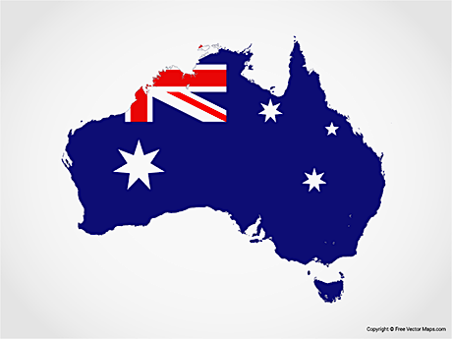
AUSTRALIA DAY
New Beginnings

Slide 2
AUSTRALIA has been a land of new beginnings for all who have made a home here
God is a god of new beginnings for all who seek him, take the step to follow him and even for those who fail and need to start over

Slide 3
AUSTRALIA has accepted people from many nations and become a nation of diverse ethnic and cultural backgrounds
God accepts all who come to him through Jesus and makes them one people

Slide 4
AUSTRALIA seeks and advocates egalitarianism yet there are many inequities
In God’s family all are equal irrespective of ethnicity, gender, or economic status.
[The church has not always practiced this well]

Slide 5
AUSTRALIAN citizens have privileges and responsibilities commensurate with citizenship
God’s children are citizens of heaven which should make them better citizens of Australia because they follow the selfless way of Jesus Christ and live by his credo to love your neighbour as yourself and to treat others as you would have them treat you

Slide 6
AUSTRALIA DAY
New Beginnings

